Slide 1



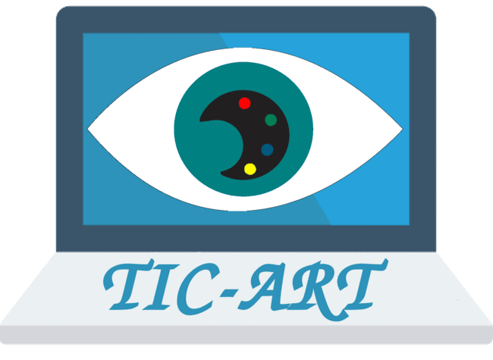
A Gaze into the Art World: Predicting Visual Attention Using Deep Learning
Presented by :
Mohamed A. KERKOURI, Univ. Orléans, Orléans
Thesis Director :
Aladine CHETOUANI, Univ. Orléans, Orléans
Jury :
Olivier LE MEUR, InterDigital, Rennes
Lu ZHANG, INSA Rennes, Rennes
Patrick LE CALLET, Univ. Nantes, Nantes
Sylvie TREUILLET, Univ. Orleans, Orléans
Frederic DUFAUX, Central Suplec, Paris
Sabine Süsstrunk, EPFL, Laussane , Suisse
Notes:
Thank you M. President
I would Like to thank all the present jury members, in person and online who allocated time for the dissertation of the thesis about predicting visual attention for art.

Slide 2


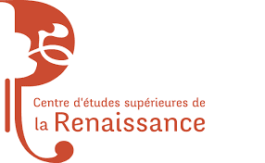

Context
10+museums Region CVL
Notes:
This thesis is part of the TicArt Project funded By Region CVL
It’s a colab between PRISME Lab , C2RMF, CESR Tours, Association des musée CVL, & 10+ musuems in CVL region

Slide 3
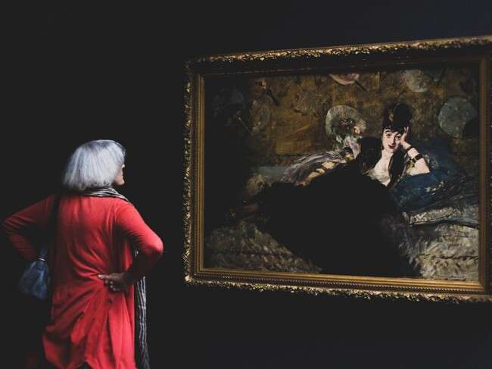
Context
Behavior analysis
Using eye-tracking
Study the perceptual patterns.
Predictive modeling of visual behavior.
https://medium.com/s/story/how-to-look-at-paintings-9e8145f32a54
Notes:
It thesis aims to study visual behaviour on painting, through :Eye Tracking , perceptual pattern recognition and predictive visual attention modelling.

Slide 4
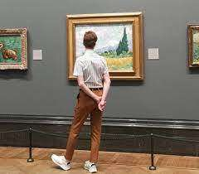
Context
Adapt exhibitions according to visitors
https://miro.medium.com/v2/resize:fit:828/format:webp/1*t61tT942g4ag2Imt4vk5Ew.jpeg
Notes:
The primary goals of this project for museums are to gain insights into visitor’s visual behaviour and preferences, and develop tools that would allow them to tailor and adapt their exhibitions to better meet the needs and interests of their audience.

Slide 5
Outline
Context
Problem Formulation
Data
Collection
Joint Saliency & Scanpath Prediction
Conclusion
Inter Observer Consistent Training
Self-Supervised representation modeling
Domain Adaptive Gaze Modeling
Notes:
We started this presentation with the context,
We will then try to formulate the problem of visual attention and context we are interested in We will move on to the contributions found in this thesis starting by Data Collection, then modelling through several other contributions ….

Slide 6

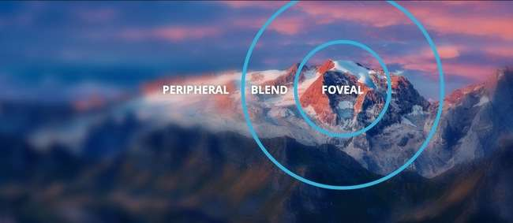
Problem formulation
https://venturebeat.com/wp-content/uploads/2019/07/tobii.jpg
Notes:
Human vision allows us to view scenes in a very high definition,
this grants us the ability for fine grained recognition.
In reality this high-definition vision represents only a small part of the visual field at the center and is called foveal vision field. As we move to the edges the vision gets increasingly blurrier, and we call it peripheral vision.

Slide 7
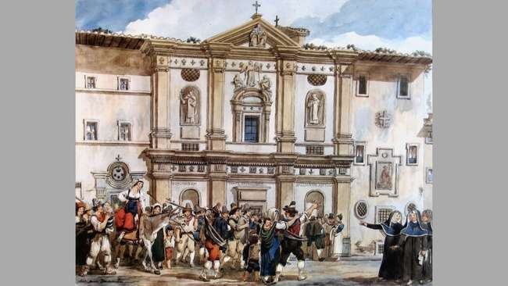
Problem formulation
https://venturebeat.com/wp-content/uploads/2019/07/tobii.jpg
Notes:
This is San Dionisio alle Quattro Fontane by Achille Pinelli
A really beautiful painting to appriciate

Slide 8

Problem formulation
https://venturebeat.com/wp-content/uploads/2019/07/tobii.jpg
Notes:
But in reality this is what we actually see.
Out Human Visual System only selects specific regions from the visual fields in order to understand and reconstruct the scene
This behavior is guided by the mechanism we call visual attention, which can be observed through overt visual attention.

Slide 9
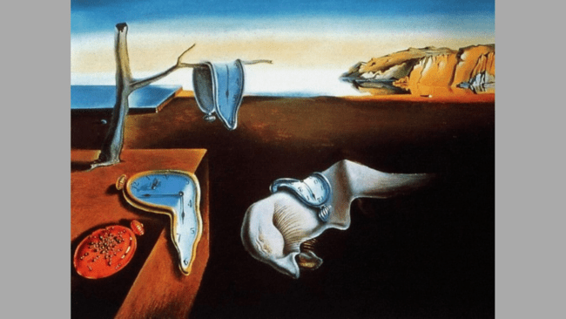
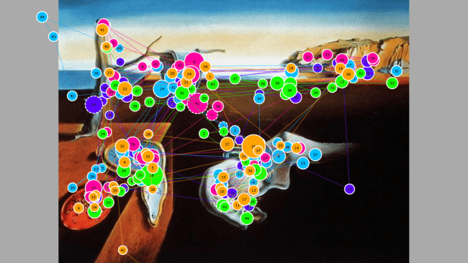
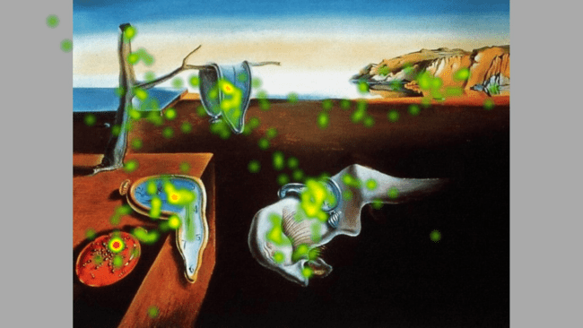
Problem formulation
We study how a person looks at an image and analyze it.
Stimulus
Scanpaths of a viewers
Saliency map
Notes:
The sequence of coordinates taken by an observer throughout the stimulus is what we call a scanpath
And by aggregating the fixations composing the scanpath we can construct a saliency map.
It ‘s a heatmap that represents the degree of prominence of each pixel for the visual system.
Our goal is study this eye movement behavior on observers watching paintings.

Slide 10
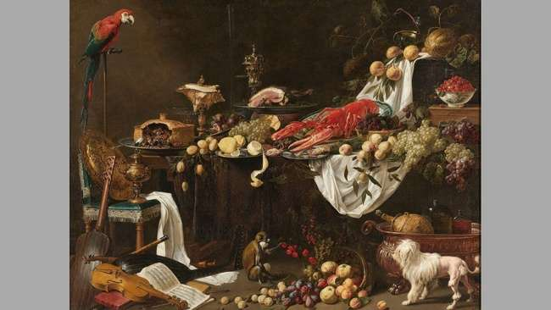








Gaps & Research Questions
Datasets
Paintings
Models
Several Scanpaths
Visual Behaviour
Time
Subjectivity
Metrics
Notes:
Through a survey of the research present in this we identified several gaps & research questions that need to be addressed:
1. Lack of Comprehensive & Consequent datasets in the Art Domain
2. Paintings Present a Different Type of Stimuli than Natural Images
3. Absence of Predictive Models Tailored Towards Art
4. A Single Image May Offer Several Viable Scanpath Options
5. Observers Exhibit Varying Viewing Behaviours
6. Fixation Duration Prediction Poses a Modelling Challenge
7. Challenges in Incorporating Subjectivity into Computational Models
8. Comprehensive Metrics for Comparing Scanpaths are Lacking Consensus.

Slide 11
Gaps & Research Questions
Datasets
Paintings
Models
Several Scanpaths
Visual Behaviour
Time
Subjectivity
Metrics
Notes:
Throught the thesis we focused on the first 5 questions.

Slide 12
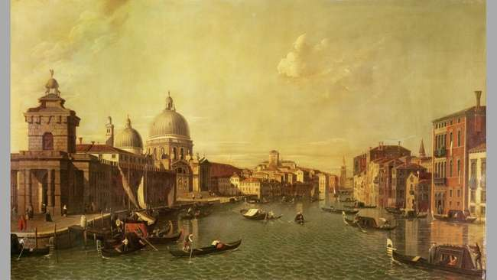


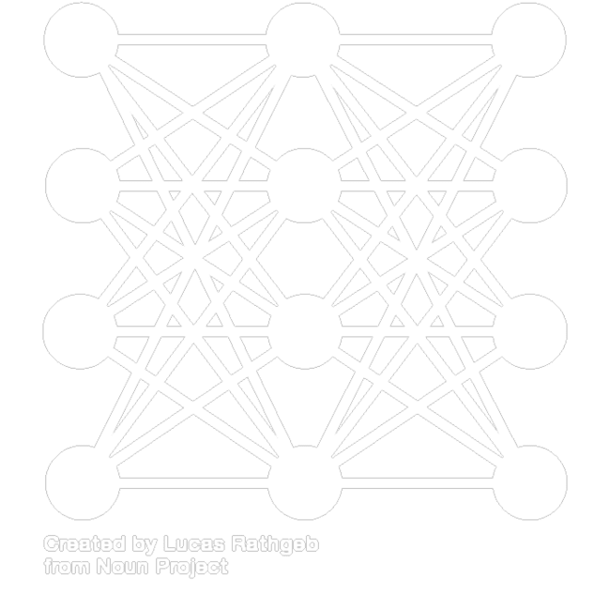

Contributions
Dataset
Models
Art Representations
Inter-Observer Disparity
Notes:
The contributions yielded this thesis could be divided into data collection related, and predictive modeling related.
The first contribution is Data Collection & analysis.
We move into proposing several predictive models
One of our main goals is :
Improving the representation ability of neural networks in the art domain,
and
Improve the predictive ability of the inter observer disparity.

Slide 13
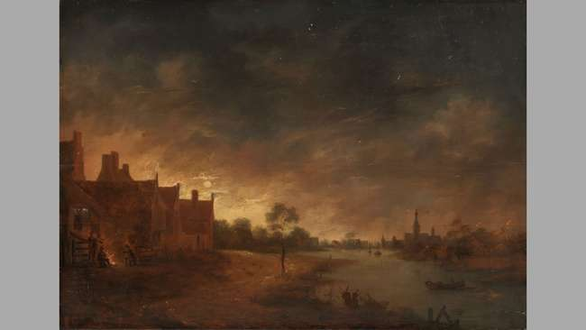
Data Collection
Notes:
Starting by Data collection, where The goal is to provide a dataset for painting and eye-tracking data.
This needed us to devised an experimental plan.

Slide 14
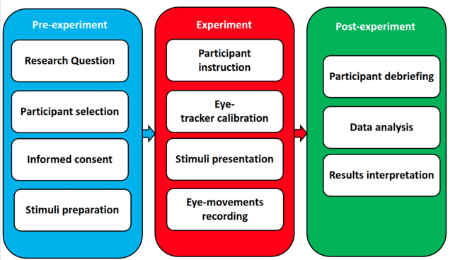
Experiment
Notes:
In order to collect the data we divide the process into 3 Stages
A preparatory pre experimentation stage, an experimental stage where we conduct experiments, and an analytical post-experimentation step.

Slide 15
Experiment
Notes:
Prior to the experiments, we defined the goal of our effort as collecting as much data as possible for paintings.
We tried to collect paintings images. We chose Public domain images. And conducted few analysis in order to ensure the diversity of content and spatial distributions.
Each image was transformed into 16:9 ratio with gray bands.
We needed to select participants, due to circumstances, we selected participants based on availability.
We also prepared a consent form for the participants.

Slide 16
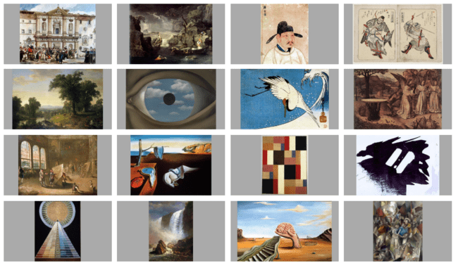
Image Analysis
Notes:
Here are examples of the paintings collected for the dataset, Each painting was transformed into a 16:9 ratio image, following the same method as the Le Meur painting dataset.
We filled the edges of the paintings using neutral grey bands.
These are several examples of the paintings in this dataset

Slide 17
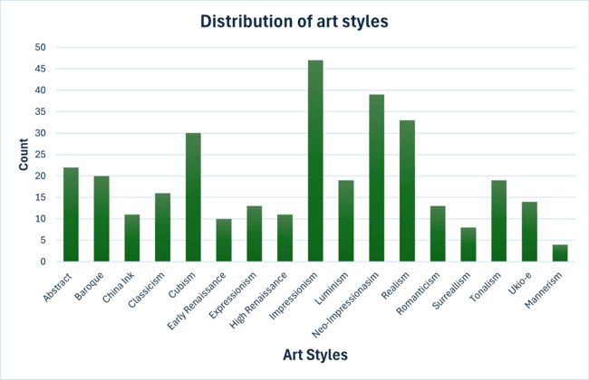
Image Analysis
Notes:
The painting cover a diverse set of artistic styles, periods and schools.
We can see that the dataset has been collected from several art styles.
There is a high number of data for impressionism & neo-impressionism. Paintings for these styles are very abundant and mostly belong to the public domain.
Nonetheless we chose old styles like early renaissance to modern styles like cubism
And we ensured diversity in subjects from abstract art to realistic styles in the realism movement.
We also included oriental styles like Chinese ink paintings and Japanese Ukio-e

Slide 18
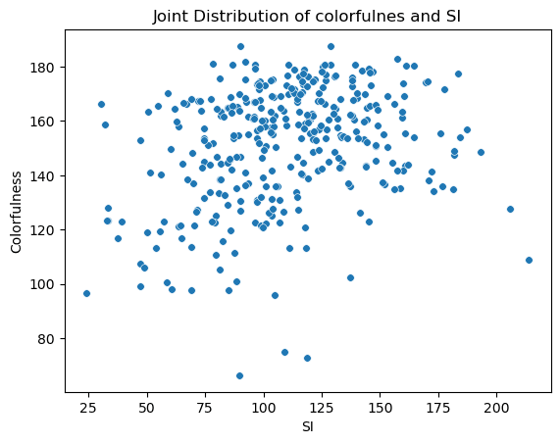
Image Analysis
Notes:
And In order to ensure the perceptual diversity of the dataset
we used Spatial Information and Colourfulness to ensure a distribution that spans paintings with low and high texturization.
As well as images that span high and low color richness.

Slide 19
Experiment
Notes:
During the experiments,
Each participants was instructed to freely look at and appreciate the paintings.
Eye-tracking calibration was ensured through the Eye tracker proprietary software.

Slide 20
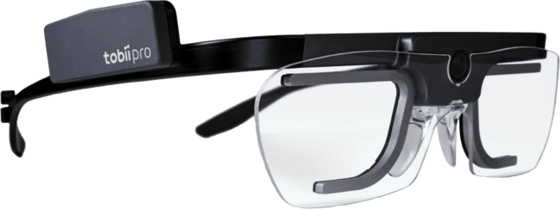
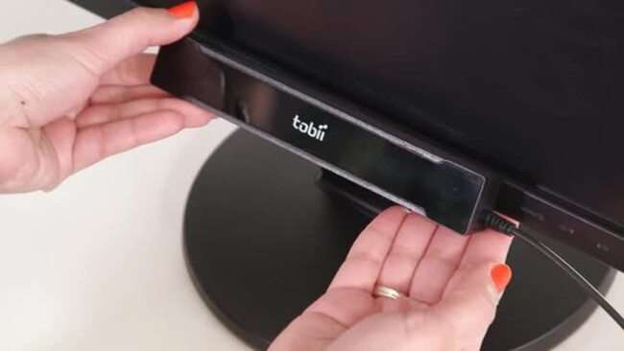

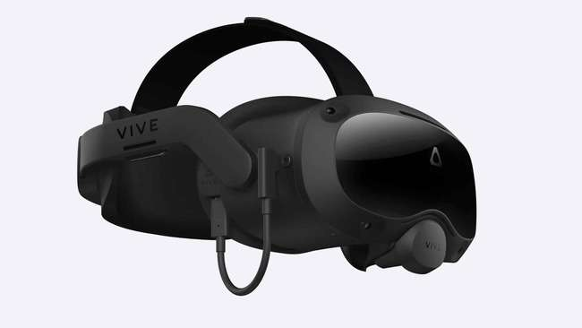
Eye Tracking
Notes:
There are several types of eye trackers that could be used and are available in the market.

Slide 21
Eye Tracking
Notes:
Due to the nature of our stumuli we can either use the IR screen based Eye trackers or the Webcam based eye-trackers.

Slide 22
Eye Tracking
Tobii X2-30 Eye Tracker Compact Edition
Sampling rate | 30 Hz (std. dev. approx 2 Hz)
System latency | 50 – 70 ms
Recommended screen size | Up to 25” (16:9)
Operating distance | 40 - 90 cm (15.7 - 33.5‘’)
Accuracy | 0.4°
Precision | 0.32°
Tobii X2-30
Notes:
After Covid we went back to the IR screen-based Eye tracker and we used a Tobii X2-30 with the specification presented in the table. It was coupled with the Tobii Studio Software.

Slide 23







Experiment
340
16
5.5
15
55-65 cm
25”
Tobii X2-30
Notes:
For the experiment we used 340 paintings,
belonging to 16 styles
Each participant viewed the image for 5.5 seconds with a 1.5 seconds interval between paintings for retina refreshment.
We had 15 participants for each image.
And planed an ideal viewing distance of 55-65 cm from the screen .
The experiments were done on the same 27” screen.

Slide 24
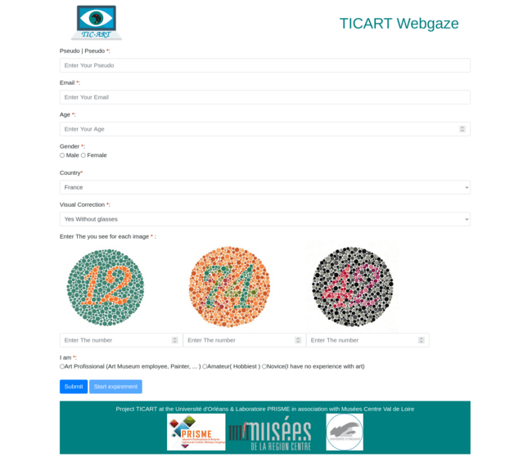
Participant Form
Notes:
We also collected some meta data from each participant.
Including there Age , gender country of origine and
Visual acuity.

Slide 25
Experiment
Notes:
After the conclusion of all experiments,
We need to analyze the collected data and the sampled population

Slide 26
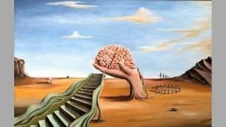
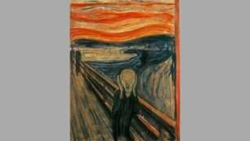
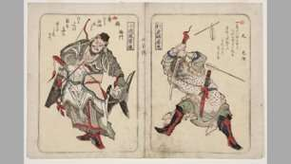
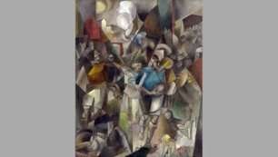
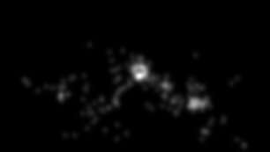
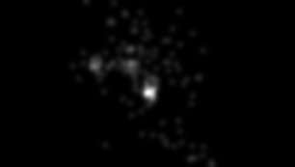
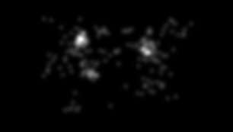
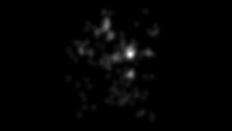
Dataset
Notes:
These are examples of some paintings with their saliency maps .

Slide 27
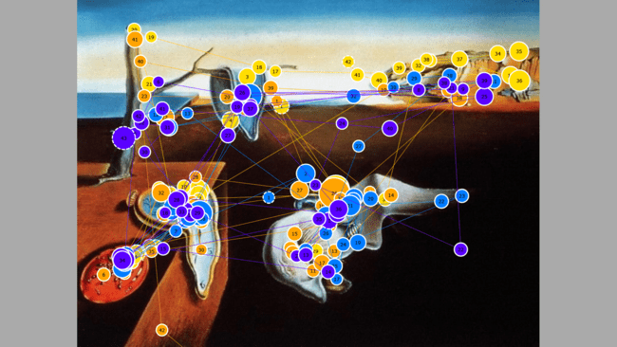
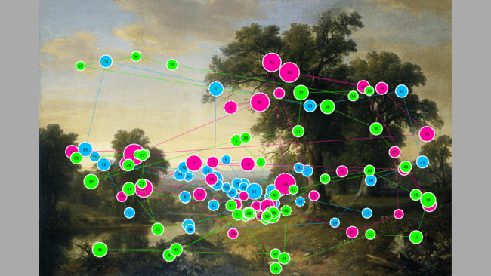
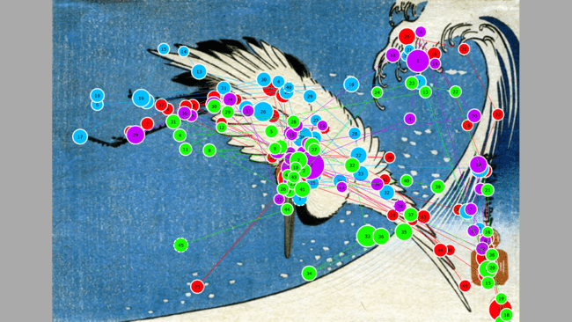
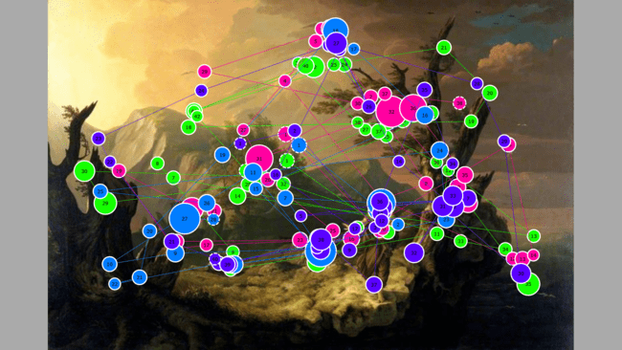
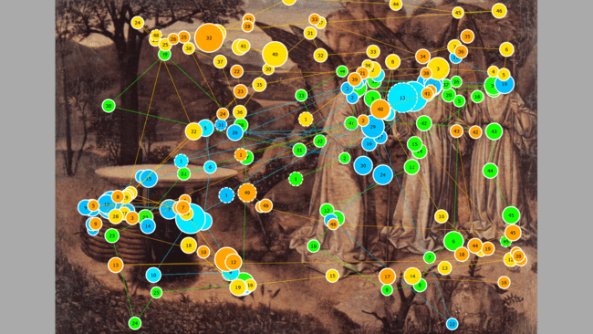
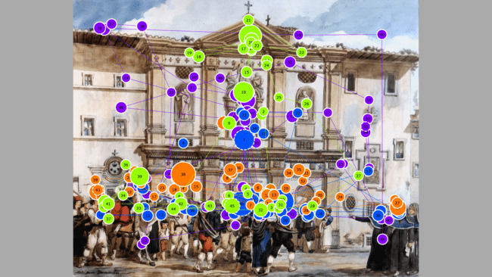
Dataset
Notes:
These are also some other data representing the scanpaths of several users overlaid on the painting images.

Slide 28
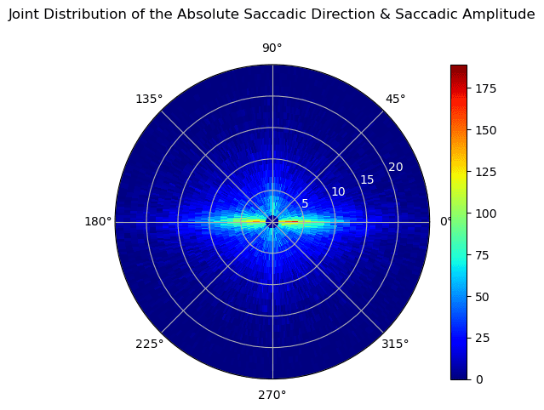
Dataset
Notes:
We can also analyze the joint dist of the saccadic lengths and directions.
It fits well with common viewing behavior,

Slide 29
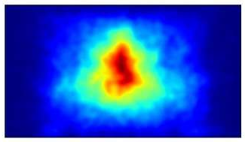
Dataset
Notes:
We can also use the visualize the general spatial ditributionof all fixationsinthe dataset
A clear central bias effect can well observed .

Slide 30
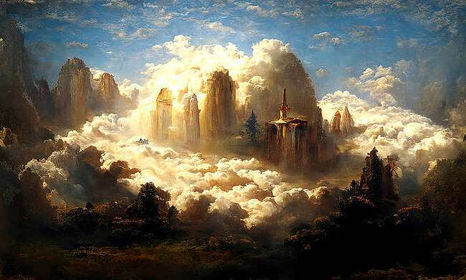
Dataset
The dataset represents a valuable contribution to the community
It can be leveraged to some extent develop and asses computational approaches

Slide 31
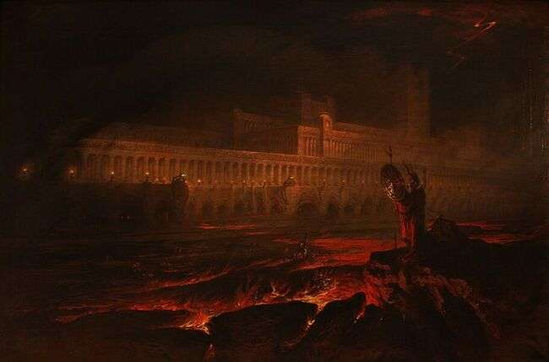
The Size of the Dataset isn’t Sufficient for the Training of Data Greedy Methods

Slide 32
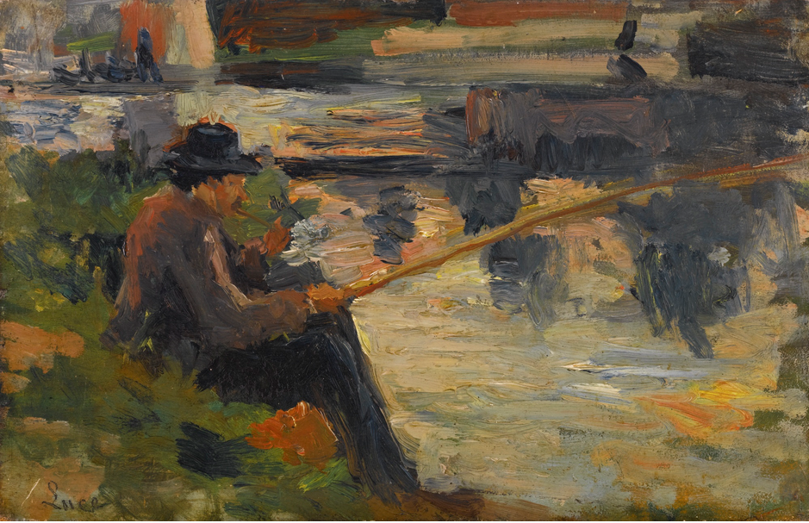
Visual Attention Modelling
Notes:
The second part of our contributions is the visual attention modeling
Where we propose several models for the tasks of visual attention and scanpath prediction.

Slide 33
Computational Modelling for Visual Saliency & Scanpath
Sampling from Saliency Map
Iterative frameworks
Scanpath
Prediction
G-EyMol
Le Meur​
DSCM
ROI-IOR LSTM
Stand Alone deep models
Sampling from Saliency Volume
PathGan
Saltinet ​
Bao, Wentao, and Zhenzhong Chen. "Human scanpath prediction based on deep convolutional saccadic model." Neurocomputing 404 (2020): 154-164
Chen, Zhenzhong, and Wanjie Sun. "Scanpath Prediction for Visual Attention using IOR-ROI LSTM." IJCAI. 2018
Notes:
Iterative framworks

Slide 34
Computational Modelling for Visual Saliency & Scanpath
Sampling from Saliency Map
Iterative frameworks
Scanpath
Prediction
G-EyMol
Le Meur​
DSCM
ROI-IOR LSTM
Stand Alone deep models
Sampling from Saliency Volume
PathGan
Saltinet ​
Le Meur, Olivier, and Zhi Liu. "Saccadic model of eye movements for free-viewing condition." Vision research 116 (2015): 152-164
Zanca, Dario, Stefano Melacci, and Marco Gori. "Gravitational laws of focus of attention." IEEE transactions on pattern analysis and machine intelligence 42.12 (2019): 2983-2995
Notes:
Saliency sampling

Slide 35
Computational Modelling for Visual Saliency & Scanpath
Sampling from Saliency Map
Iterative frameworks
Scanpath
Prediction
G-EyMol
Le Meur​
DSCM
ROI-IOR LSTM
Stand Alone deep models
Sampling from Saliency Volume
PathGan
Saltinet ​
Assens Reina, Marc, et al. "Saltinet: Scan-path prediction on 360 degree images using saliency volumes." Proceedings of the IEEE International Conference on Computer Vision Workshops. 2017
Assens, Marc, et al. "PathGAN: Visual scanpath prediction with generative adversarial networks." Proceedings of the European Conference on Computer Vision (ECCV) Workshops. 2018
Notes:
Saltinet
PAthGAN

Slide 36
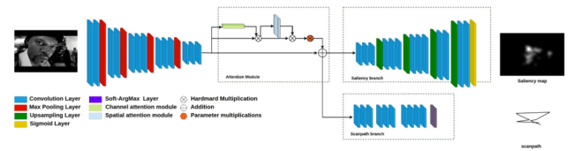
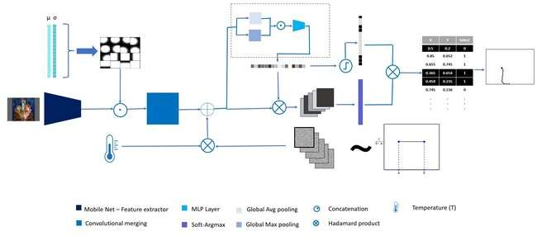
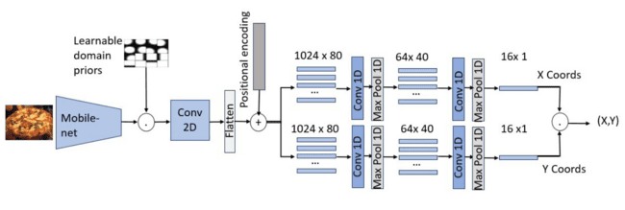
Computational Modelling for Visual Saliency & Scanpath
Kerkouri, Mohamed A., et al. "Salypath: A deep-based architecture for visual attention prediction." 2021 IEEE International Conference on Image Processing (ICIP). IEEE, 2021
Kerkouri, Mohamed Amine, et al. "A domain adaptive deep learning solution for scanpath prediction of paintings." Proceedings of the 19th International Conference on Content-based Multimedia Indexing. 2022.
Tliba, Marouane, et al. "Self supervised scanpath prediction framework for painting images." Proceedings of the IEEE/CVF Conference on Computer Vision and Pattern Recognition. 2022
Notes:
This would represents a glimps of the models we are proposing

Slide 37
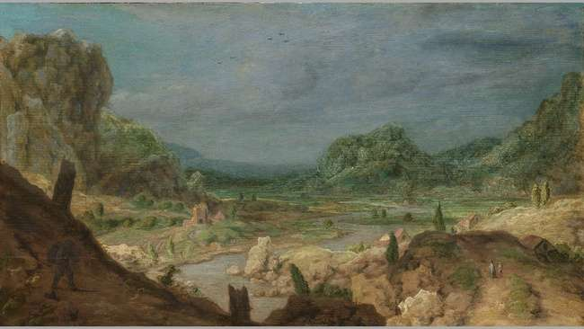
Joint Saliency & Scanpath Prediction
Notes:
Our first model aims to jointly predict the scanpath and saliency maps for a given image.

Slide 38
Contributions
Computational Modelling for Visual Saliency and Scanpath
Improving the networks representation through multiple related tasks
Notes:
Our goals are to create a computational model and
improve the networks representation ability by training on 2 related tasks .

Slide 39
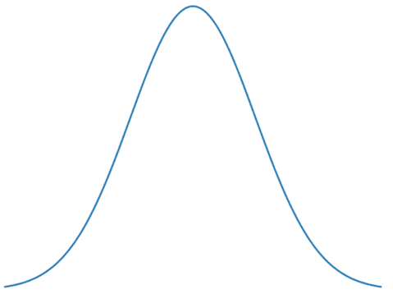
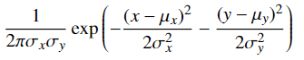
Relationship
Gaussian
Fixations
Saliency
Christof Koch and Shimon Ullman. Shifts in selective visual attention: towards the underlying neural circuitry. In Matters of intelligence, pages 115–141. Springer, 1987.
Notes:
We know that there is a very important and causal relationship between saliency and scanpaths,
Basically in order togenrate a saleicny map we need to collected and aggregate fixations from several users.
By creating a fixation map and passing the smoothening gaussian filter we can optain a heatmap representing the saliency of regions on the stimuli.

Slide 40
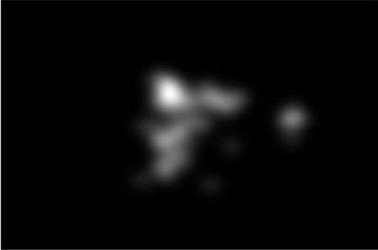
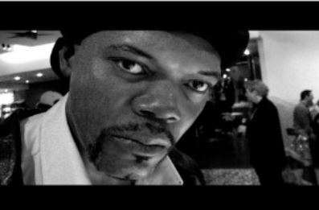
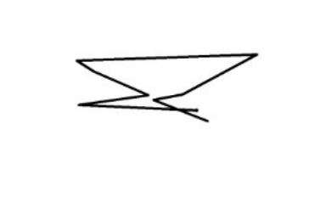
Joint Saliency & Scanpath modelling
Shared Saliency &
Scanpath Features
Model
Saliency Map
Image
General Schema of the model
Scanpath
M. A. Kerkouri, M. Tliba, A. Chetouani and R. Harba, "Salypath: A Deep-Based Architecture For Visual Attention Prediction," 2021 IEEE International Conference on Image Processing (ICIP), Anchorage, AK, USA, 2021, pp. 1464-1468, doi: 10.1109/ICIP42928.2021.9506295.
Notes:
Our goal is exploit this relationship and train our model to extract better features related to the visual attention in the image.
We are trying to improve the feature extractors ability to recognize salient feature.

Slide 41
Joint Saliency & Scanpath modelling
M. A. Kerkouri, M. Tliba, A. Chetouani and R. Harba, "Salypath: A Deep-Based Architecture For Visual Attention Prediction," 2021 IEEE International Conference on Image Processing (ICIP), Anchorage, AK, USA, 2021, pp. 1464-1468, doi: 10.1109/ICIP42928.2021.9506295.
Notes:
This is our presented end-to-end architecture for the model, which is completely composed of convolutional layers.

Slide 42
Joint Saliency & Scanpath modelling
M. A. Kerkouri, M. Tliba, A. Chetouani and R. Harba, "Salypath: A Deep-Based Architecture For Visual Attention Prediction," 2021 IEEE International Conference on Image Processing (ICIP), Anchorage, AK, USA, 2021, pp. 1464-1468, doi: 10.1109/ICIP42928.2021.9506295.
Notes:
Model is composed from 2 branches for prediction,
The first is a streamlined autoencoder for saliency prediction.

Slide 43
Joint Saliency & Scanpath modelling
M. A. Kerkouri, M. Tliba, A. Chetouani and R. Harba, "Salypath: A Deep-Based Architecture For Visual Attention Prediction," 2021 IEEE International Conference on Image Processing (ICIP), Anchorage, AK, USA, 2021, pp. 1464-1468, doi: 10.1109/ICIP42928.2021.9506295.
Notes:
The second branch uses the extracted features to predict the scanpath in a parallel.

Slide 44
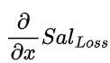


Joint Saliency & Scanpath modelling
Saliency Gradient
Joint tasks Gradient
Scanpath Gradient
Notes:
Our main goal was to get a feature extractor that leanes from both the scanpath and saliency losses.
Our 2 decoder branches each learn from a respective gradient for the respective loss
While the feature extractor goal is to learn from both gradients.

Slide 45
Joint Saliency & Scanpath modelling
Scanpath Prediction
M. A. Kerkouri, M. Tliba, A. Chetouani and R. Harba, "Salypath: A Deep-Based Architecture For Visual Attention Prediction," 2021 IEEE International Conference on Image Processing (ICIP), Anchorage, AK, USA, 2021, pp. 1464-1468, doi: 10.1109/ICIP42928.2021.9506295.
Notes:
The scanpath prediction branch is fully convolutional

Slide 46

Soft-ArgMax Function
Scanpath Prediction
Diogo C. Luvizon, Hedi Tabia and David Picard. Human Pose Regression by Combining Indirect Part Detection and Contextual Information. CoRR, vol. abs/1710.02322, 2017.
Notes:
In order to predict the fixations coordinates we employ the Soft ArgMax function
The function itself takes a 2D feature map as input and outputs the coordinates of the highest activation, just like the ArgMax function. ,
The difference is that this function is differentiable compared to the discrete ArgMax Function

Slide 47



Soft-ArgMax Function
Scaling & normalization
Diogo C. Luvizon, Hedi Tabia and David Picard. Human Pose Regression by Combining Indirect Part Detection and Contextual Information. CoRR, vol. abs/1710.02322, 2017.
Notes:
SAM Arch.
This function works in this manner , at first it scales and normlalises the features map, leading to the amplification of strong signals and the attenuation of weak ones.

Slide 48


Soft-ArgMax Function
ⓧ
μ
x
μ
y
ⓧ
Notes:
SAM Arch.
The normalized map is then multiplated by 2 Gradient maps each representing a special direction.
By calculating the mean of the resulting maps we get an approximation of the argmax location.

Slide 49
Joint Saliency & Scanpath modelling
Attention Module
Sanghyun Woo, Jongchan Park, Joon-Young Lee and In So Kweon. Cbam: Convolutional block attention module. In Proceedings of the European conference on computer vision (ECCV), pages 3–19, 2018
Notes:
Another important component of our model is the attention module we employed.
This module helps further refine the features by amplifying important feature on both the channel and the spatial dimensions.
This filtering and refining of the features helps further improve the performance of the feature map.

Slide 50



Datasets & Training ​
The model was trained on the training set of the SALICON Dataset ( 10000 images ).
It was tested on the validation set of the SALICON Dataset ( 5000 images).
MIT 1003
The model was tested on the MIT1003 Dataset, without any transfer learning (Cross-Dataset test) with a 1003 images.
Notes:
For the testing protocol we employ natural scene images datasets for development, as they have high volume of data.
We employ the Salicon for training and testing and MIT 1003 datasets only for testing without fine tuning .

Slide 51





Metrics Multimatch
Shape
Direction
Length
Position
Duration
Halszka Jarodzka, Kenneth Holmqvist and Marcus Nyström. A Vector-Based, Multidimensional Scanpath Similarity Measure. In Proceedings of the 2010 Symposium on Eye-Tracking Research & Applications, ETRA ’10, page 211–218, New York, NY, USA, 2010. Association for Computing Machinery.
Notes:
We employ 3 metrics, the first is the multimatch metric :
It’s a vector based metric, which compares 2 scanpaths.
The metric compares 5 attributes of the scanpaths :
Shape: It quantifies the similarity in shape between the scanpaths represented as vectors.
Direction: It assesses the difference in angle between saccades in the scanpaths
Length: It evaluates the discrepancy in length between saccades
Position: It computes the dissimilarity in positions be- tween the fixation locations in the scanpaths
Duration:It assesses the discrepancy in saccade durations between the model-predicted scanpaths and the observed scanpaths

Slide 52


Metrics NSS
Robert J Peters, Asha Iyer, Laurent Itti and Christof Koch. Components of bottom-up gaze allocation in natural images. Vision research, vol. 45, no. 18, pages 2397–2416, 2005
Notes:
The other metrics are hybrid metrics that compare scanpaths with the original saliency maps,
The NSS metric measures the mean saliency value of the scanpath fixations.
We employ the Salicon and MIT 1003 datasets.

Slide 53

Metrics Congruency
Olivier Le Meur, Thierry Baccino and Aline Roumy. Prediction of the inter-observer visual congruency (IOVC) and application to image ranking. In Proceedings of the 19th ACM international conference on Multimedia, pages 373–382, 2011.
Notes:
Congruency calculate the agreement between the predicted scanpath and distribution of ground truth scanpaths.
It calculates the ratio of the fixations that fall into salient regions

Slide 54

Results 1 (Quantitative)
MIT 1003
Notes:
We evaluate the saliency prediction of our model on the MIT1003

Slide 55

Results 1 (Quantitative)
MIT 1003
Notes:
We also compare the scanpaths predicted on the MIT1003 dataset.

Slide 56

Results 1 (Qualitative)
Notes:
Here is a comparison of the scanpaths and saliency maps with the ground truth.

Slide 57


Results 1 (Quantitative)
Notes:
We also calculated the scanpath prediction ability on the LE Meur Paintings and AVAtt dataset.

Slide 58

Results (Qualitative)
Notes:
Here are some results .
We can clearly see that the scanpaths fit the salient regions

Slide 59
Dataset
The Model Successfully Leverages the training Approach Through Related Tasks
A Fully Convolutional Non-Iterative end-to-end model
Notes:
Follow up stats

Slide 60
The Model is only able to Predict a Single Scanpath per Image, which doesn’t Completely Correspond to Reality
The Model doesn’t Take the Time Dimension into Account
Notes:
Follow up stats

Slide 61

Domain Adaptive Gaze Modelling
Notes:
Our second modeling method is the domain adapative gaze modeling

Slide 62
Contributions
Computational Modelling for Visual Saliency and Scanpath
Improving the networks representation ability for the art domain
Generative Scanpath Prediction for Images

Slide 63
Contributions
Computational Modelling for Visual Saliency and Scanpath
Improving the networks representation ability for the art domain
Generative Scanpath Prediction for Images
Notes:
Our first contribution

Slide 64

Domain Adaptive modelling
Mohamed Amine Kerkouri, Marouane Tliba, Aladine Chetouani, and Alessandro Bruno. 2022. A domain adaptive deep learning solution for scanpath prediction of paintings. In Proceedings of the 19th International Conference on Content-based Multimedia Indexing (CBMI '22). Association for Computing Machinery, New York, NY, USA, 57–63. https://doi.org/10.1145/3549555.3549597
Notes:
this is our proposed model

Slide 65
Domain Adaptive modelling
Mohamed Amine Kerkouri, Marouane Tliba, Aladine Chetouani, and Alessandro Bruno. 2022. A domain adaptive deep learning solution for scanpath prediction of paintings. In Proceedings of the 19th International Conference on Content-based Multimedia Indexing (CBMI '22). Association for Computing Machinery, New York, NY, USA, 57–63. https://doi.org/10.1145/3549555.3549597
Notes:
It’s composed of a feature extraction part

Slide 66
Domain Adaptive modelling
Mohamed Amine Kerkouri, Marouane Tliba, Aladine Chetouani, and Alessandro Bruno. 2022. A domain adaptive deep learning solution for scanpath prediction of paintings. In Proceedings of the 19th International Conference on Content-based Multimedia Indexing (CBMI '22). Association for Computing Machinery, New York, NY, USA, 57–63. https://doi.org/10.1145/3549555.3549597
Notes:
A main feature of our model is the prior map module

Slide 67




Domain Adaptive modelling
Extend the concept
Central Bias
Learned Priors
Sabira K Mannan, Keith H Ruddock and David S Wooding. The relationship between the locations of spatial features and those of fixations made during visual examination of briefly presented images. Spatial vision, 1996.
Notes:
This module would extend the central bias theorem, Which states that fixations tend to fall on the center of the image.
By extending the notion to several prior that are learned through the training.

Slide 68
Domain Adaptive modelling
Mohamed Amine Kerkouri, Marouane Tliba, Aladine Chetouani, and Alessandro Bruno. 2022. A domain adaptive deep learning solution for scanpath prediction of paintings. In Proceedings of the 19th International Conference on Content-based Multimedia Indexing (CBMI '22). Association for Computing Machinery, New York, NY, USA, 57–63. https://doi.org/10.1145/3549555.3549597
Notes:
This part is the scanpath prediction module

Slide 69
Domain Adaptive modelling
Mohamed Amine Kerkouri, Marouane Tliba, Aladine Chetouani, and Alessandro Bruno. 2022. A domain adaptive deep learning solution for scanpath prediction of paintings. In Proceedings of the 19th International Conference on Content-based Multimedia Indexing (CBMI '22). Association for Computing Machinery, New York, NY, USA, 57–63. https://doi.org/10.1145/3549555.3549597
Notes:
We employed the SAM function like in the previous model.

Slide 70
Domain Adaptive modelling
Mohamed Amine Kerkouri, Marouane Tliba, Aladine Chetouani, and Alessandro Bruno. 2022. A domain adaptive deep learning solution for scanpath prediction of paintings. In Proceedings of the 19th International Conference on Content-based Multimedia Indexing (CBMI '22). Association for Computing Machinery, New York, NY, USA, 57–63. https://doi.org/10.1145/3549555.3549597
Notes:
The model also has a fixation selection module, which selects the appropriate fixation for the scanpath.

Slide 71

Domain Adaptive modelling
Notes:
It generates a mask that would classifiy the fixations through a dynamic threshold.
During training we alsoadded some information about the length of the scanpath into loss function.

Slide 72
Datasets & Training ​
The model was trained on the training set of the SALICON Dataset ( 10000 images ).
It was tested on the validation set of the SALICON Dataset ( 5000 images).
MIT 1003
The model was tested on the MIT1003 Dataset, without any transfer learning (Cross-Dataset test) with a 1003 images.
Notes:
We used the same training and validation method

Slide 73

Results 2.1 (Quantitative)
MIT 1003

Slide 74

Results 2.1 (Qualitative)

Slide 75


Results 2.1 (Qualitative)
Notes:
Talk about modeling the scanpaths

Slide 76


Results 2.1 (Painting)
Notes:
As our main purpos is the prediction on paintings we calculated the baseline performance of our model on painting.

Slide 77

Results 2.1 (Qualitative)

Slide 78
Contributions
Computational Modelling for Visual Saliency and Scanpath
Improving the networks representation ability for the art domain
Generative Scanpath Prediction for Images
Notes:
To improve our results we try to improve the model representation ability

Slide 79

Domain Adaptation
Notes:
Using Dimentionality Reduction we ploted the distribution of features extracted by our model for some painting and natural images,
We can notice a clear devide in the representations, meaning our model defirentiates between paintings and natural images

Slide 80

Domain Adaptation
Notes:
Our Goal is make the model improve this ability by having behave in the same manner when viewing the paintings.
In other words we want our model to confound the 2 Distributions.

Slide 81

Domain Adaptation
Before
Domain Adaptation
After
Domain Adaptation
Notes:
To Achive that we use Domain adaptation method, where we try to push the model to learn only the important mutual features and discard the non important noises.

Slide 82


Method ( Domain Adaptation )
Natural scene
Painting
Classifier
Gradient reversal
Layer
L
Task Decoder
x,y X,Y
Encoder
Yaroslav Ganin, Evgeniya Ustinova, Hana Ajakan, Pascal Germain, Hugo Larochelle, François Laviolette, Mario March and Victor Lempitsky. Domain-Adversarial Training of Neural Networks. Journal of Machine Learning Research, vol. 17, no. 59, pages 1–35, 2016
Notes:
The method we used addes a classifier to the encoder feature extractor, in parallele to the downstream task.
The classifier job is to classify the imagesas natural scenes or paintings.

Slide 83
Method ( Domain Adaptation )
Natural scene
Painting
Classifier
Gradient reversal
Layer
L
Task Decoder
x,y X,Y
Encoder
Yaroslav Ganin, Evgeniya Ustinova, Hana Ajakan, Pascal Germain, Hugo Larochelle, François Laviolette, Mario March and Victor Lempitsky. Domain-Adversarial Training of Neural Networks. Journal of Machine Learning Research, vol. 17, no. 59, pages 1–35, 2016
Notes:
By employing a gradient reversal layer that
Reverses the sign of the gradient weforce the encoder to confound the distributions while the classifier triesto discriminate them .

Slide 84
Results 2 (Painting)
Notes:
We had successful results on both LE Meur and AVAtt datasets.

Slide 85

Results (Qualitative)
Notes:
Here are some visualizations

Slide 86
Contributions
Computational Modelling for Visual Saliency and Scanpath
Improving the networks representation ability for the art domain
Generative Scanpath Prediction for Images
Notes:
The thirs point is to make our model generative, meaning to genrateseveral scanpaths for the same image.

Slide 87
SPGen
Notes:
Wefurther extend our model

Slide 88
SPGen
Notes:
We add this module to be able to generate several scanpaths per images

Slide 89




SPGen

Slide 90
SPGen
Notes:
This module samples a a randome value feature maps from a probability distribution .

Slide 91
SPGen
Notes:
Then modulate it through a hyperparamter of temperture

Slide 92

Results (Quantitative)
MIT 1003
Random Sampling from Uniform Distribution
Notes:
These are the results obtained through sampling uniform distribution

Slide 93

Results (Quantitative)
MIT 1003
Random Sampling from Normal Distribution
Notes:
And these are the results obtained through sampling from a normal distribution
We get a better overall Multimatch mean,

Slide 94

Results (Qualitative)
MIT 1003
Random Sampling from Normal Distribution
Notes:
These are some of the results obtained through various tempertures

Slide 95

Results (Quantitative)
Random Sampling from Normal Distribution + Random selection of Modulation Temperature
Notes:
We also evaluate the model using random tempertures on both the AVAtt and Le Meur datasets.

Slide 96

Results (Quantitative)
Random Sampling from Normal Distribution + temperature = 0 (ε)
Notes:
Here we use the same tempresture to demonstrate the ability of our model to generate several scanpaths for the same image

Slide 97
Dataset
We Presented a new model architecture that Introduces Scanpath Length Stochasticity
A Model that predicts Scanpaths in a Generative manner
The Unsupervised Domain Adaptation Method permits the Exploitation of Unlabeled Data
Notes:
Follow up stats

Slide 98
The generative method introduces a reduction of Inter-Observer Agreement, and doesn’t simulate real Inter-Observer disparity
The Model doesn’t Take the Time Dimension into Account
Notes:
Follow up stats

Slide 99

Self-Supervised Representation Learning
Notes:
The third approach is about self supervised learning

Slide 100
Contributions
Computational Modelling for Visual Saliency and Scanpath
Improving the networks representation ability for the art domain
Provide an art native unsupervised training method

Slide 101
Contributions
Computational Modelling for Visual Saliency and Scanpath
Improving the networks representation ability for the art domain
Provide an art native unsupervised training method
Notes:
We first start with

Slide 102
Method ( Proposed Model )
Marouane Tliba, Mohamed Amine Kerkouri, Aladine Chetouani, Alessandro Bruno; Proceedings of the IEEE/CVF Conference on Computer Vision and Pattern Recognition (CVPR) Workshops, 2022, pp. 1539-1548
Notes:
This is the new architecture proposed

Slide 103
Method 3
Marouane Tliba, Mohamed Amine Kerkouri, Aladine Chetouani, Alessandro Bruno; Proceedings of the IEEE/CVF Conference on Computer Vision and Pattern Recognition (CVPR) Workshops, 2022, pp. 1539-1548
Notes:
We also use Learnable domain priors as the previous method

Slide 104
Method 3
Marouane Tliba, Mohamed Amine Kerkouri, Aladine Chetouani, Alessandro Bruno; Proceedings of the IEEE/CVF Conference on Computer Vision and Pattern Recognition (CVPR) Workshops, 2022, pp. 1539-1548
Notes:
In order to employ the lighter 1D conv
We flatten the extracted features, but add a positional encoding module that ensures informations about positions.

Slide 105
Method 3
Marouane Tliba, Mohamed Amine Kerkouri, Aladine Chetouani, Alessandro Bruno; Proceedings of the IEEE/CVF Conference on Computer Vision and Pattern Recognition (CVPR) Workshops, 2022, pp. 1539-1548
Notes:
To predict the scanpath we use 2 branches

Slide 106
Method 3
Marouane Tliba, Mohamed Amine Kerkouri, Aladine Chetouani, Alessandro Bruno; Proceedings of the IEEE/CVF Conference on Computer Vision and Pattern Recognition (CVPR) Workshops, 2022, pp. 1539-1548
Notes:
They are composed of blocks of 1D conv and Max pooling

Slide 107
Method 3
No convergence with a single branch
Notes:
We used 2 parallel branches where each is responsible for the prediction in one dimensional space.
The use of a single branch didn’t lead to convergence during training,
This is due the lack of inherent correlation between the coordinates of fixations.

Slide 108
Datasets & Training ​
The model was trained on the training set of the SALICON Dataset ( 10000 images ).
It was tested on the validation set of the SALICON Dataset ( 5000 images).
MIT 1003
The model was tested on the MIT1003 Dataset, without any transfer learning (Cross-Dataset test) with a 1003 images.
Notes:
We also employ the same training and testing protocol

Slide 109

Results 3
MIT 1003
Notes:
We better results for the multimatch metrics compared to other methods

Slide 110



Results 3
Notes:
Results on painting datasets

Slide 111

Results 3
Notes:
These are some visualtions of the results
We notice the long tail to the origine

Slide 112
Contributions
Computational Modelling for Visual Saliency and Scanpath
Improving the networks representation ability for the art domain
Provide a native unsupervised training method
for the art domain
Notes:
Next to improveour results in paintings we devise a self supervised training strategy to improve the representation ability of our feature extractor

Slide 113

Self supervised Learning
SSL aims to learn representations of data without the need for explicit labels.
Jure Zbontar, Li Jing, Ishan Misra, Yann LeCun and Stéphane Deny. Barlow twins: Self-supervised learning via redundancy reduction. In International Conference on Machine Learning, pages 12310–12320. PMLR, 2021

Slide 114
Self supervised Learning
Jure Zbontar, Li Jing, Ishan Misra, Yann LeCun and Stéphane Deny. Barlow twins: Self-supervised learning via redundancy reduction. In International Conference on Machine Learning, pages 12310–12320. PMLR, 2021
Notes:
The goal of this method is to learn important features of the image though reducing redundancy of the features
It employs diffrent augmentations of the same imagein order to learn important repeated features

Slide 115
Self supervised Learning
Jure Zbontar, Li Jing, Ishan Misra, Yann LeCun and Stéphane Deny. Barlow twins: Self-supervised learning via redundancy reduction. In International Conference on Machine Learning, pages 12310–12320. PMLR, 2021
Notes:
We create embeddings of the 2 features

Slide 116
Self supervised Learning
Jure Zbontar, Li Jing, Ishan Misra, Yann LeCun and Stéphane Deny. Barlow twins: Self-supervised learning via redundancy reduction. In International Conference on Machine Learning, pages 12310–12320. PMLR, 2021
Notes:
And calculate the correlation matrix between the embeddings

Slide 117

Self supervised Learning
Jure Zbontar, Li Jing, Ishan Misra, Yann LeCun and Stéphane Deny. Barlow twins: Self-supervised learning via redundancy reduction. In International Conference on Machine Learning, pages 12310–12320. PMLR, 2021
Notes:
We then compare the features with a indent matrix to reduce the mutual information between features and amplify the amount of self information on each feature

Slide 118






Neural Style Transfer (NST)
50,000 Painting Images.
Introduce Neural style Transfer as an
image augmentation method.
5 paintings Styles were chosen.
Notes:
Relaying on that method, start by introducing an art specific augmentation technique,
We use the neural style transfer which uses a content image and repaintes it using a style image.
We used 5 Styles for our augmentation.
As presented at the bottom of the slide

Slide 119

Method 3 ( Self supervised Learning )
Marouane Tliba, Mohamed Amine Kerkouri, Aladine Chetouani, Alessandro Bruno; Proceedings of the IEEE/CVF Conference on Computer Vision and Pattern Recognition (CVPR) Workshops, 2022, pp. 1539-1548
Notes:
This is our training approach

Slide 120
Method 3 ( Self supervised Learning )
Marouane Tliba, Mohamed Amine Kerkouri, Aladine Chetouani, Alessandro Bruno; Proceedings of the IEEE/CVF Conference on Computer Vision and Pattern Recognition (CVPR) Workshops, 2022, pp. 1539-1548
Notes:
Which uses the barlow twins method at it’s core .

Slide 121
Method 3 ( Self supervised Learning )
Marouane Tliba, Mohamed Amine Kerkouri, Aladine Chetouani, Alessandro Bruno; Proceedings of the IEEE/CVF Conference on Computer Vision and Pattern Recognition (CVPR) Workshops, 2022, pp. 1539-1548
Notes:
We use the NST overlaied with other random transformations like cropping in order to generate our distorted inputes

Slide 122
Method 3 ( Self supervised Learning )
Marouane Tliba, Mohamed Amine Kerkouri, Aladine Chetouani, Alessandro Bruno; Proceedings of the IEEE/CVF Conference on Computer Vision and Pattern Recognition (CVPR) Workshops, 2022, pp. 1539-1548
Notes:
We first update the model using the barlow twins method

Slide 123

Method 3 ( Self supervised Learning )
Notes:
But then we employ the Moving Average method in order to stabilize the training

Slide 124
Method 3 ( Self supervised Learning )
Marouane Tliba, Mohamed Amine Kerkouri, Aladine Chetouani, Alessandro Bruno; Proceedings of the IEEE/CVF Conference on Computer Vision and Pattern Recognition (CVPR) Workshops, 2022, pp. 1539-1548
Notes:
We save styles representations into a style bank and update the model to reduce the distance between style representations and the Global original image representation.

Slide 125
Results 3
Notes:
This method yieled improvements on all metrics as shown in these results.

Slide 126
Results 3
Notes:
And here is a visual comparison between the base mode and the new model

Slide 127
Dataset
We Presented a new model architecture that uses lightweight 1D Convolutions
A new training approach that employs art specific image transformations
An art native training approach that improves the representative ability of the model

Slide 128
The Model is only able to Predict a Single Scanpath per Image, which doesn’t Completely Correspond to Reality
The Model doesn’t Take the Time Dimension into Account
Notes:
Follow up stats

Slide 129
Inter-Observer Consistent Training
Notes:
Our next challenge would be to improve the prediction to take into account inter observer diversity

Slide 130
Contributions
Computational Modelling for Visual Saliency and Scanpath
Improving the model's representation ability for Inter-Observer disparity

Slide 131


Inter Observer Consistency
Notes:
When training at first we usuly use a single randomly chosen scanpath for training,
But this method doesn’t ensure that the learned scanpath isn’t closer to one uses compared to the other ona given image.

Slide 132
Inter Observer Consistency
Notes:
Our aim is predict a scanpath that most observers would be able to agree on
In other words, a scanpath that is equidistant from all users.

Slide 133
Network Architecture
Kerkouri, Mohamed Amine et al. “An Inter-Observer Consistent Deep Adversarial Training for Visual Scanpath Prediction.” 2023 IEEE International Conference on Image Processing (ICIP) (2022): 2595-2599.
Notes:
We employ the same model as last time for this generation

Slide 134
Inter-Observer Disparity
~
( XGTv, YGTv)
Ground Truth Scanpaths
( XGTa, YGTa)
Generator
( XP, YP)
Discriminator
( 0, 1)
Kerkouri, Mohamed Amine et al. “An Inter-Observer Consistent Deep Adversarial Training for Visual Scanpath Prediction.” 2023 IEEE International Conference on Image Processing (ICIP) (2022): 2595-2599.
Notes:
We also use an adversarial training approach inspired by GANs

Slide 135

Inter-Observer Disparity
Min-Max Game
Generator
( XP, YP)
Discriminator
( 0, 1)
Notes:
The generator and Discriminator would enter a min max game where generator ails to predict realistic scanpaths and the discriminator aims to detect the generator scanpaths as fake .

Slide 136
Inter-Observer Disparity
~
( XGTv, YGTv)
Ground Truth Scanpaths
True
( XGTa, YGTa)
Generator
( XP, YP)
Discriminator
( 0, 1)
Fake
Kerkouri, Mohamed Amine et al. “An Inter-Observer Consistent Deep Adversarial Training for Visual Scanpath Prediction.” 2023 IEEE International Conference on Image Processing (ICIP) (2022): 2595-2599.
Notes:
We use a random anchor scanpath from the ground truth distribution as well as sample a varying one.

Slide 137
Method
~
( XGTv, YGTv)
Ground Truth Scanpaths
( XGTa, YGTa)
Generator
( XP, YP)
Discriminator
( 0, 1)
Kerkouri, Mohamed Amine et al. “An Inter-Observer Consistent Deep Adversarial Training for Visual Scanpath Prediction.” 2023 IEEE International Conference on Image Processing (ICIP) (2022): 2595-2599.
Notes:
We want to minimize the distance representation between the fake predicted scanpath and the ground truthscanpaths

Slide 138
Method
~
( XGTv, YGTv)
Ground Truth Scanpaths
( XGTa, YGTa)
Generator
( XP, YP)
Discriminator
( 0, 1)
Kerkouri, Mohamed Amine et al. “An Inter-Observer Consistent Deep Adversarial Training for Visual Scanpath Prediction.” 2023 IEEE International Conference on Image Processing (ICIP) (2022): 2595-2599.
Notes:
The anchor would ensure a stability during training

Slide 139
Method
~
( XGTv, YGTv)
Ground Truth Scanpaths
( XGTa, YGTa)
Generator
( XP, YP)
Discriminator
( 0, 1)
Kerkouri, Mohamed Amine et al. “An Inter-Observer Consistent Deep Adversarial Training for Visual Scanpath Prediction.” 2023 IEEE International Conference on Image Processing (ICIP) (2022): 2595-2599.
Notes:
While the varying scanpath would try to maintain the equidistance from all scanpaths .

Slide 140
Method
~
( XGTv, YGTv)
Ground Truth Scanpaths
( XGTa, YGTa)
Generator
( XP, YP)
Discriminator
( 0, 1)
Kerkouri, Mohamed Amine et al. “An Inter-Observer Consistent Deep Adversarial Training for Visual Scanpath Prediction.” 2023 IEEE International Conference on Image Processing (ICIP) (2022): 2595-2599.
Notes:
Talk about modeling the scanpaths

Slide 141

Method
Kerkouri, Mohamed Amine et al. “An Inter-Observer Consistent Deep Adversarial Training for Visual Scanpath Prediction.” 2023 IEEE International Conference on Image Processing (ICIP) (2022): 2595-2599.
Notes:
This the architecture of the discriminator, inspired from the 2V branchesof te generator we used
Each branch used is for the dimensional coordinates

Slide 142
Method
Kerkouri, Mohamed Amine et al. “An Inter-Observer Consistent Deep Adversarial Training for Visual Scanpath Prediction.” 2023 IEEE International Conference on Image Processing (ICIP) (2022): 2595-2599.
Notes:
The features are then merged

Slide 143
Method
Kerkouri, Mohamed Amine et al. “An Inter-Observer Consistent Deep Adversarial Training for Visual Scanpath Prediction.” 2023 IEEE International Conference on Image Processing (ICIP) (2022): 2595-2599.
Notes:
And passedto a classifier

Slide 144
Datasets & Training ​
The model was trained on the training set of the SALICON Dataset ( 10000 images ).
It was tested on the validation set of the SALICON Dataset ( 5000 images).
MIT 1003
The model was tested on the MIT1003 Dataset, without any transfer learning (Cross-Dataset test) with a 1003 images.
Notes:
We used the same training and validation protocol

Slide 145

Results
MIT 1003

Slide 146

Results 3
Notes:
Visual results

Slide 147


Results 3
Notes:
The results on the painting dataset improved

Slide 148
Dataset
The Discriminator Architecture could be Reused for Scanpath Classification Task
An adversarial Training Approach that Reduces the Inter-Observer Disparity
Notes:
Follow up stats

Slide 149
The Model is only able to Predict a Single Scanpath per Image, which doesn’t Completely Correspond to Reality
The Model doesn’t Take the Time Dimension into Account
Notes:
Follow up stats

Slide 150
General Conclusion
A training method to Improve the networks representation ability for the art domain in an Unsupervised Approach
A training method to Improve the model's representation ability for Inter-Observer disparity
New Visual Attention Dataset of Visual Attention for Art
3 Computational Modelling approaches for Visual Saliency and Scanpath
Notes:
As a general conclusion

Slide 151

Perspectives
Improve metrics & loss functions for scanpaths prediction
Incorporate time aspect
Personalize the prediction of scanpaths
Notes:
Perspectives

Slide 152












Publications
Notes:
Generic conclusion

Slide 153



Thank you !
mohamed-amine.kerkouri@univ-orleans.fr
/in/mohamed-amine-kerkouri/
/profile/Mohamed-Kerkouri-2
Notes:
Thank you, I'll Add the contacts later .

Slide 154
Annexes

Slide 155
Dataset

Slide 156

COVID-19
Notes:
At the start of the thesis, Covid-19 hit, and due to restriction and social distancing guidelines, we were not able to conduct eye tracking experiments at the time.

Slide 157

Eye Tracking
https://www.tic-art.fr
Notes:
As a solution we developed an online platform for webcam based eye tracking .
But unfortunately, the precision was too low for our task.

Slide 158

Eye-Tracking Web platform
https://www.tic-art.fr

Slide 159



Participants
Ishihara CVD Test
Notes:
Talk about the procedure of the experimentation

Slide 160

Dataset
Notes:
We analyzed the viewing distance of the users.
We found dome variability.

Slide 161

Dataset
Notes:
We analyzed the viewing distance of the users.
We found dome variability.

Slide 162



Dataset
Notes:
We analyzed the viewing distance of the users.
We found dome variability.

Slide 163

Dataset
Notes:
We analyzed the viewing distance of the users.
We found dome variability.

Slide 164

Dataset
Notes:
We analyzed the viewing distance of the users.
We found dome variability.

Slide 165

Dataset
Notes:
We analyzed the viewing distance of the users.
We found dome variability.

Slide 166

Dataset
Notes:
We analyzed the viewing distance of the users.
We found dome variability.

Slide 167

Participants
Notes:
An uneven distribution of gender reflects the proportions of the female to male ratio of students in the school.

Slide 168

Participants
μ = 23
σ = 7.97
Notes:
Most of the participants were students, but we also managed to get some participants from older ages, this graph presents the age distribution of the all participants.

Slide 169

Participants
Notes:
We also had participants originating from diverse geographical and cultural backgrounds.
Including Europe, North Africa , the Sahel , the middle east, Oriental Asia and south America.

Slide 170

Dataset
Notes:
We analyzed the viewing distance of the users.
We found dome variability.

Slide 171
Dataset
99.05% of Fixations
1 User
Notes:
Basically a single user was responsible for the outliers and was excluded from the dataset.

Slide 172


Dataset
Notes:
We analyzed the viewing distance of the users.
We found dome variability.

Slide 173



Dataset
Notes:
We analyzed the viewing distance of the users.
We found dome variability.

Slide 174

Dataset
Notes:
We analyzed the viewing distance of the users.
We found dome variability.

Slide 175
Salypath

Slide 176

CBAM
Notes:
We analyzed the viewing distance of the users.
We found dome variability.

Slide 177


SAM
Notes:
We analyzed the viewing distance of the users.
We found dome variability.

Slide 178

Loss Salypath
Notes:
We analyzed the viewing distance of the users.
We found dome variability.

Slide 179

CBAM Ablation
Notes:
We analyzed the viewing distance of the users.
We found dome variability.

Slide 180

Joint Training Ablation
Notes:
We analyzed the viewing distance of the users.
We found dome variability.

Slide 181


Results (Quantitative) SALYPATH

Slide 182
Domain Adaptation

Slide 183

Domain Adaptation
Natural scene
Natural scene
Painting
Painting
Before
Domain Adaptation
After
Domain Adaptation

Slide 184

Results (Quantitative) Domain adapt

Slide 185

Results (Quantitative) Domain adapt

Slide 186
SSL representation

Slide 187

Results 3 SCNPNT

Slide 188

Positional Encoding

Slide 189

Loss

Slide 190

SSL List

Slide 191

Model Ablation

Slide 192
Inter Observer

Slide 193

Results inter observer

Slide 194
Final

Slide 195
Results inter observer

Slide 196

Results All

Slide 197

Visualization
Notes:
Define Scnapaths
And Saliency maps

